Slide 1
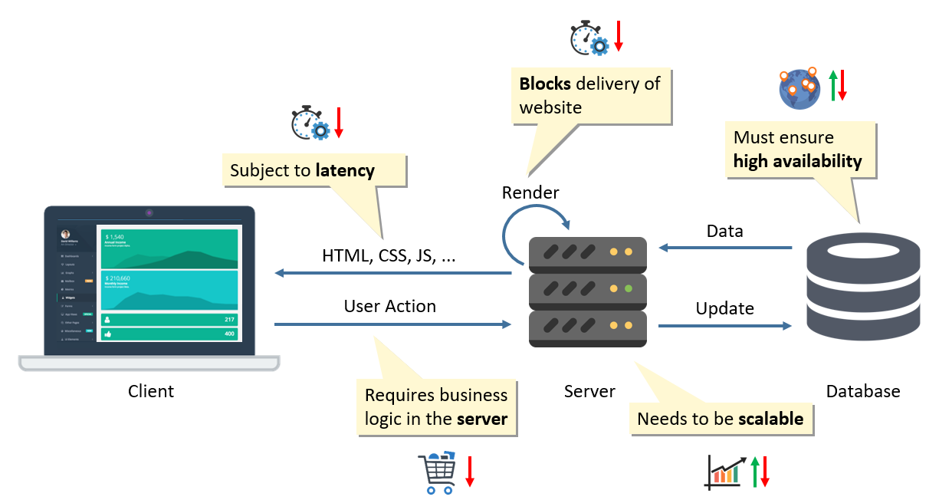

Slide 2
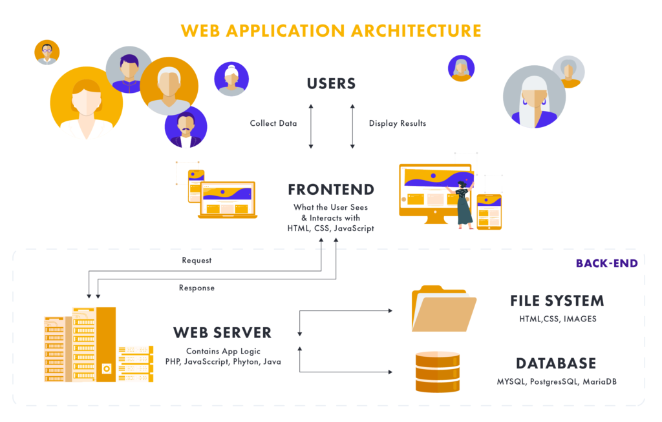

Slide 3
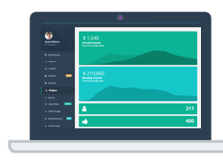

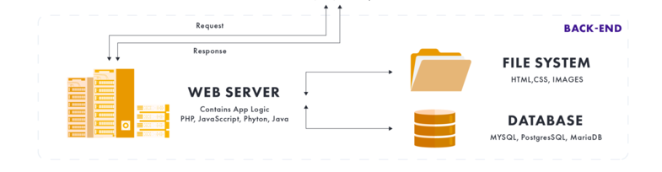


What the User/Farmer sees
-Crop health - Crop coverage - Predictive insights
-Yield estimates - Water stress - Crop soil monitoring
FRONT-END LOGIC
User-system interactivity
HTML, CSS, JavaScript
Automatic Download
GOOGLE EARTH ENGINE
Pull spatial datasets, spatial queries and analysis
GOOGLE EARTH ENGINE
Pull spatial datasets, spatial queries and analysis

Slide 4
